Slide 1
IoT Unleashed Temperature Monitor
Presenter ::
Sudhanshu Gupta

Slide 2
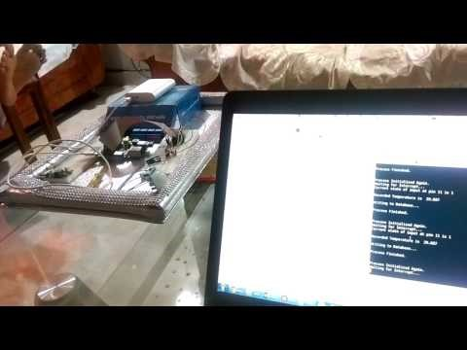
Demo
Video

Slide 3

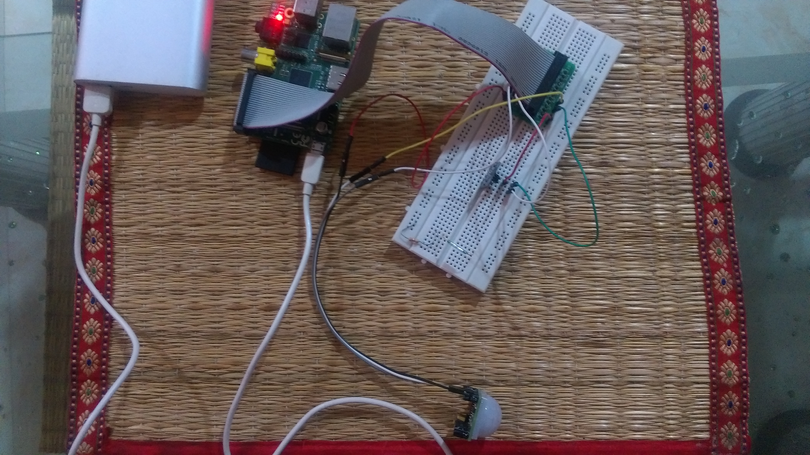
Physical Setup

Slide 4
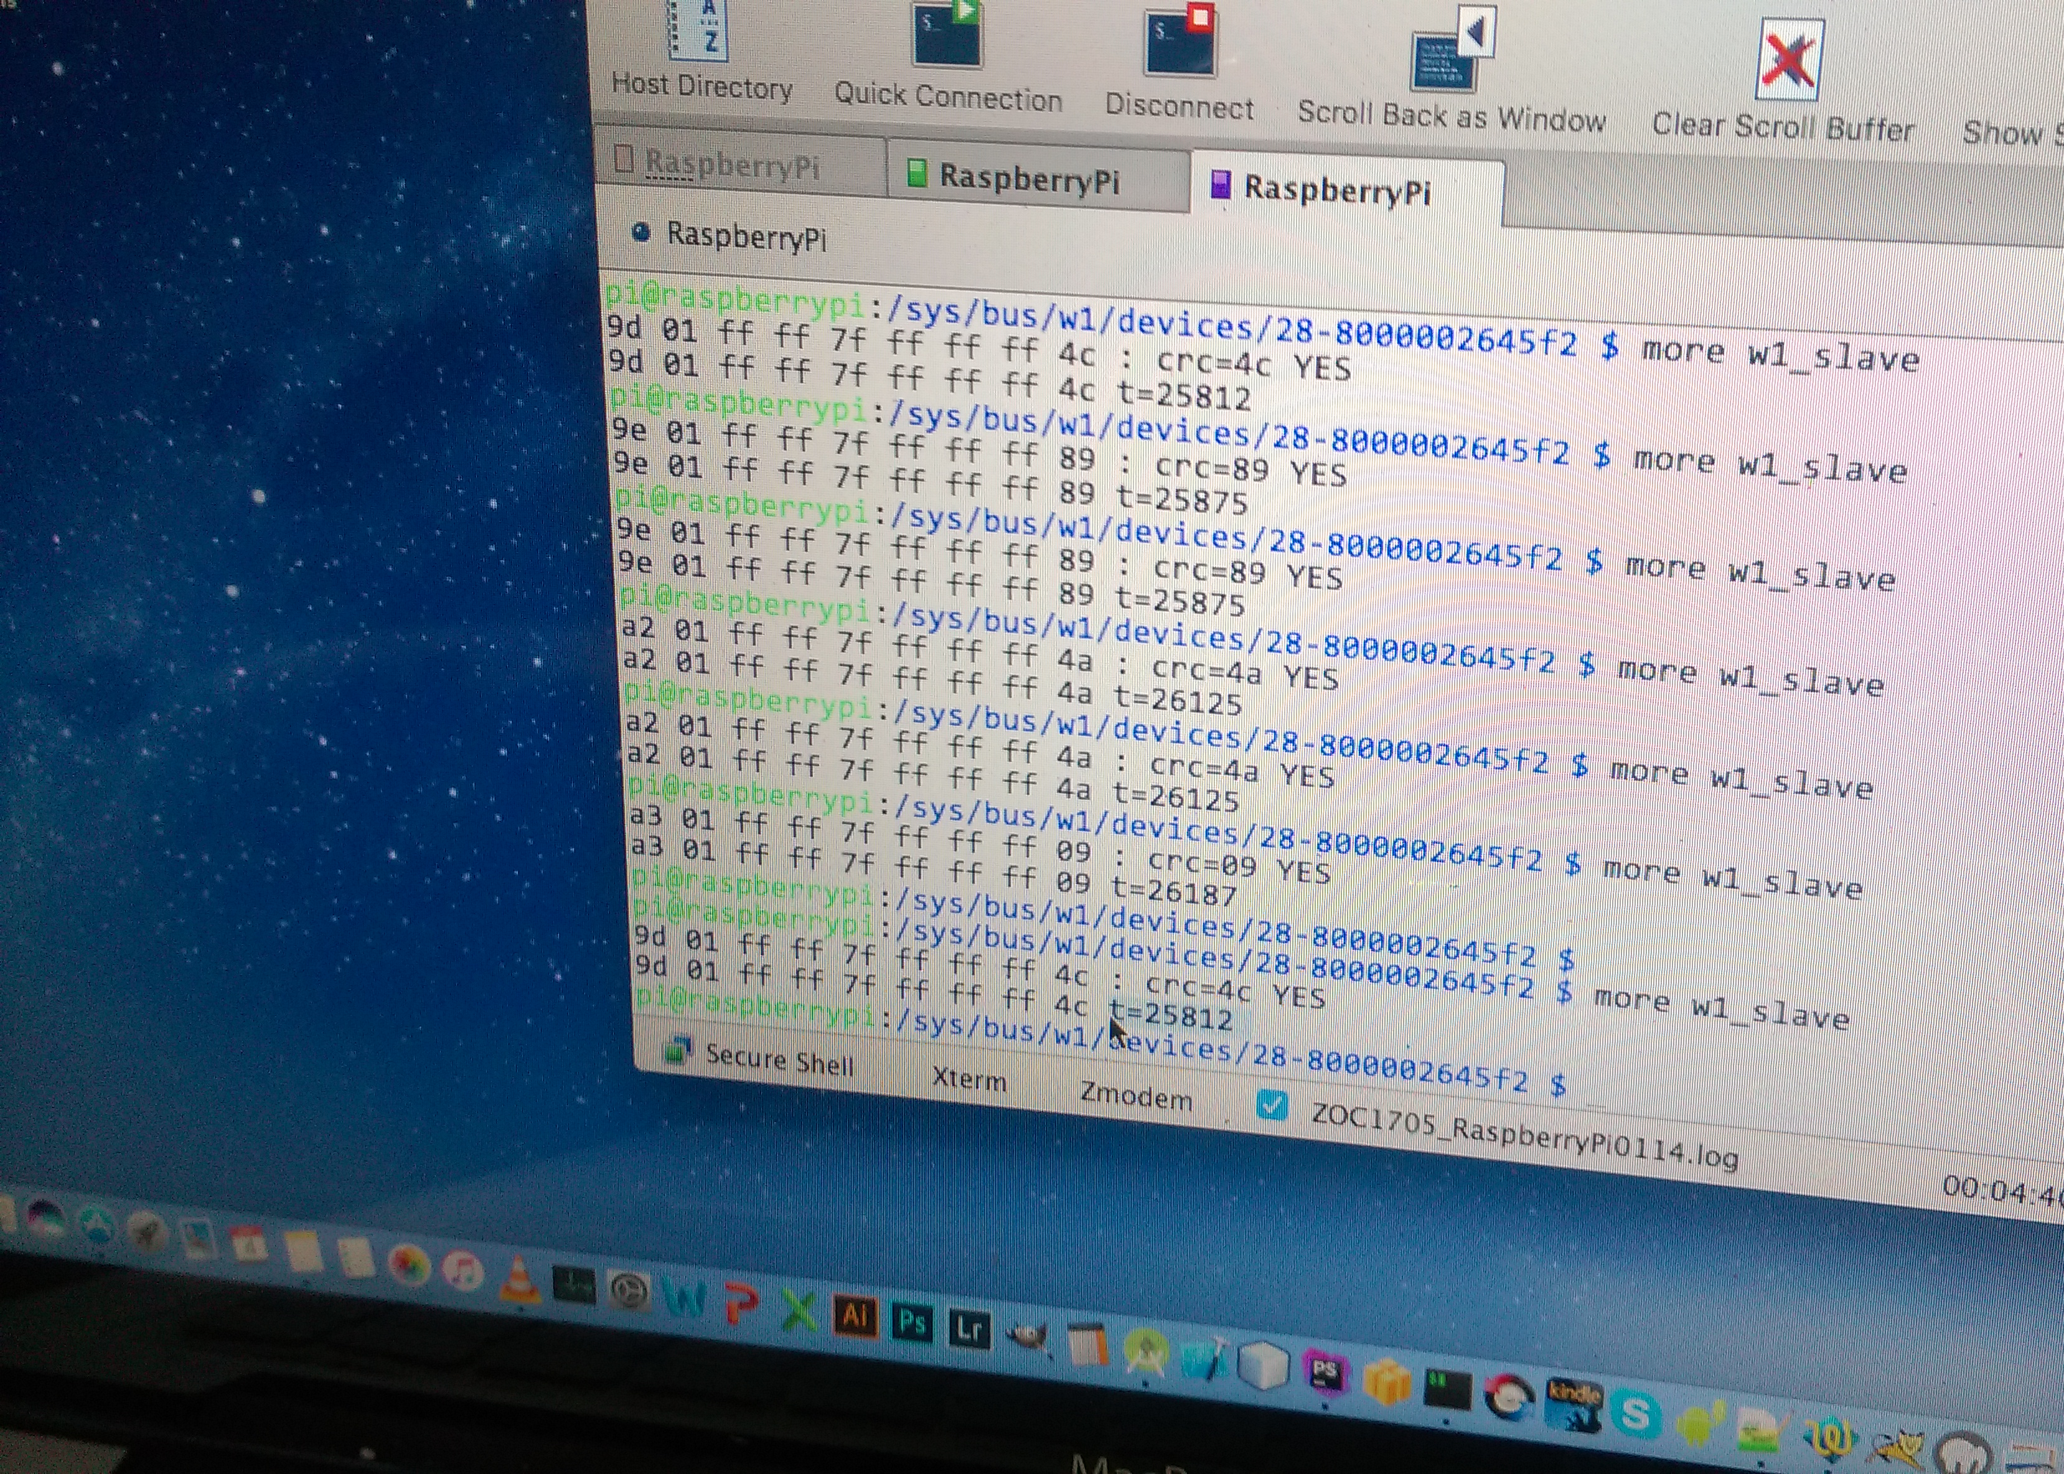

Slide 5
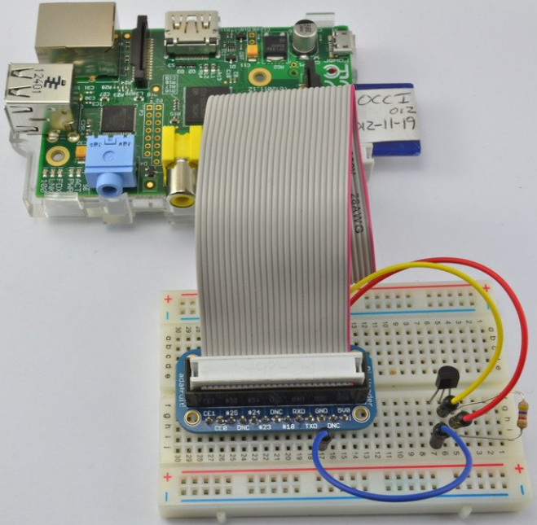

Slide 6
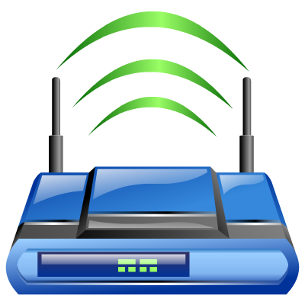

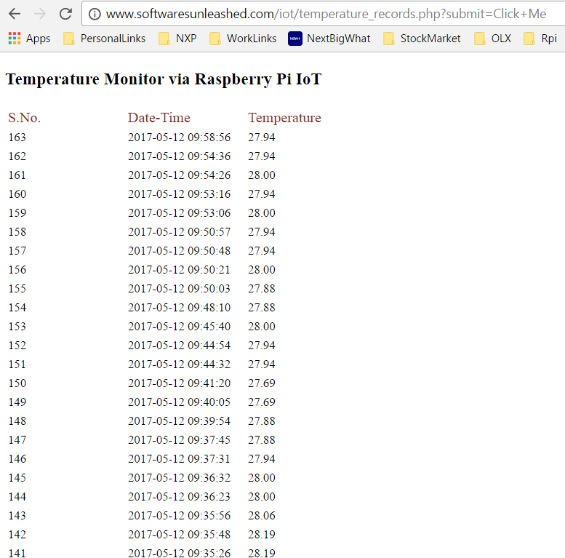
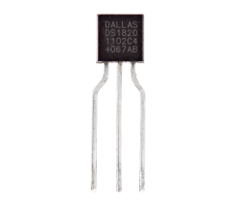
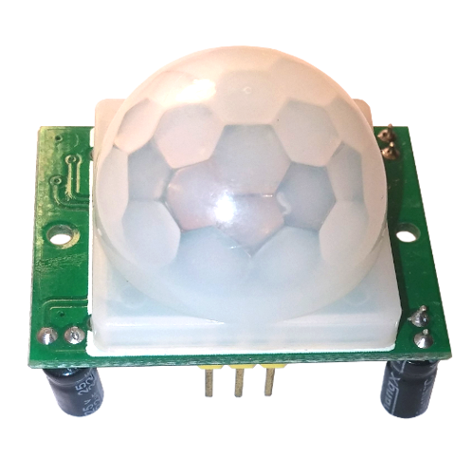
Arch Overview
Cloud Services
(Firebase / PHP)
Air Interface
WiFi
DevBoard
(Raspberry Pi)
DS1820
Temperature Sensor
GPIO
GPIO #4
3.3v
GND
5 v
PIR
Motion Sensor
GPIO #22 (Pin 11)

Slide 7



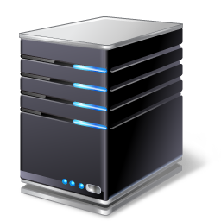
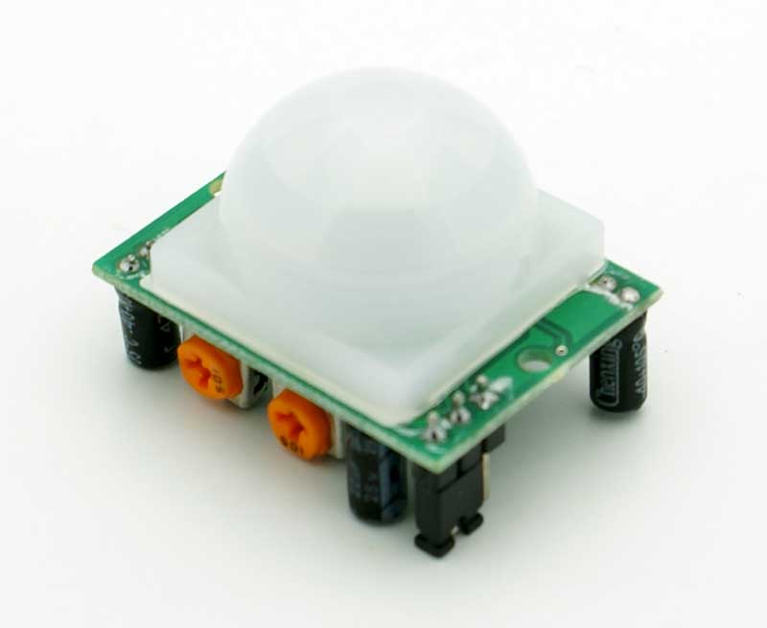

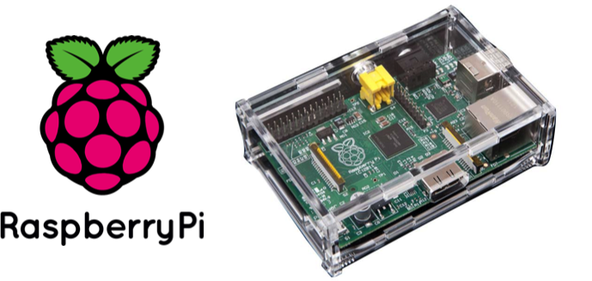
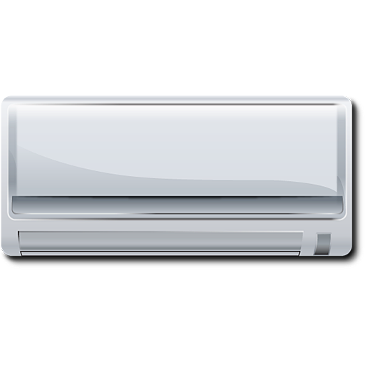
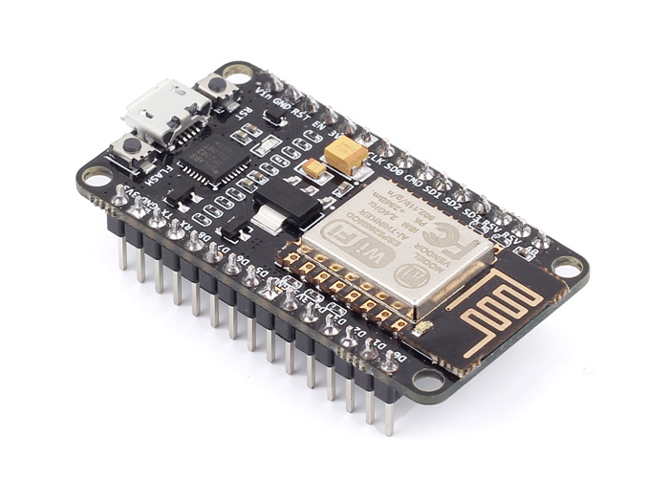
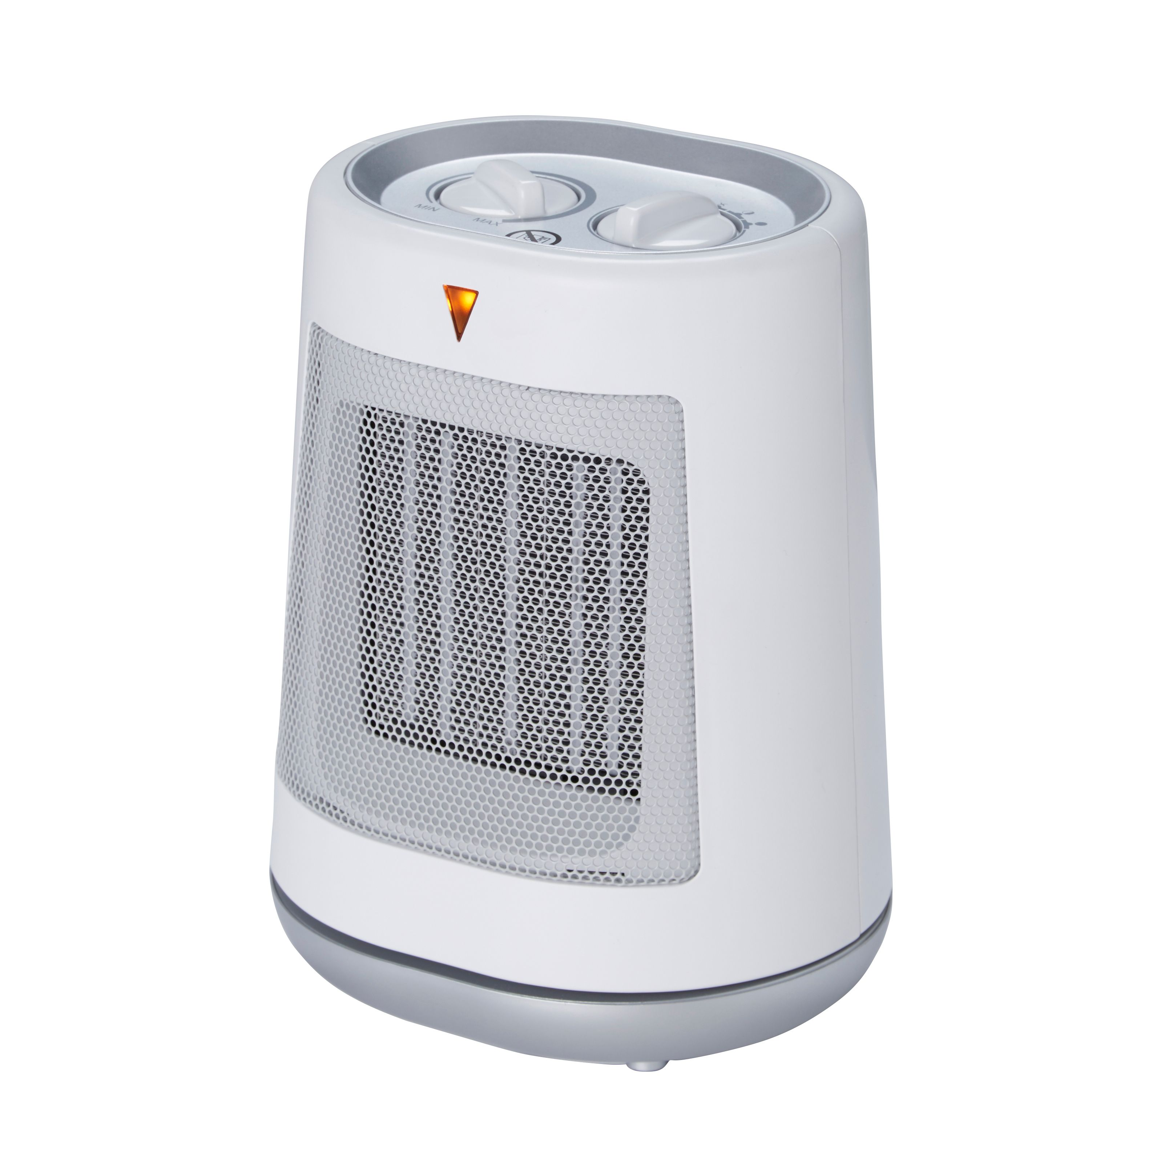
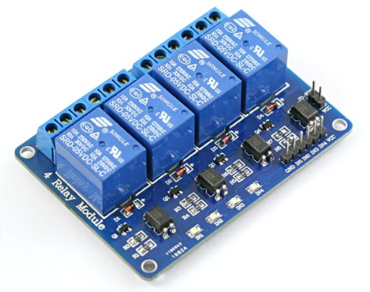
Work Flow Diagram (Scenario 1)
Acquiring & Posting Temperature Data to Cloud Services
Cloud Services
(Web+ DB Server)
PIR Motion Sensor
Temperature Sensor
DS18b20
1
3
2
Room is monitored for temperature, till the time it is occupied.
Algos running on cloud determine the weather conditions, and operate AC / Heater / Other appliances
PIR Motion Sensor , detects movement in room and interrupts Rpi.
Rpi checks current room temperature via Temp Sensor (DS18b20 – 1W Interface)
Temperature data is posted and processed at cloud (PHP / NodeJS)
Data is pushed to ESP8266 over cloud , which then controls the local appliances (AC / Heater) to maintain preset room temperature.
Switch On / Off the Appliance via Relay Module ie. Controlled by ESP8266 WiFi sub-system
4
Cooling Appliance
ESP8266 Wifi IoT
ESP8266 GPIO Pins
Heating Appliance

Slide 8


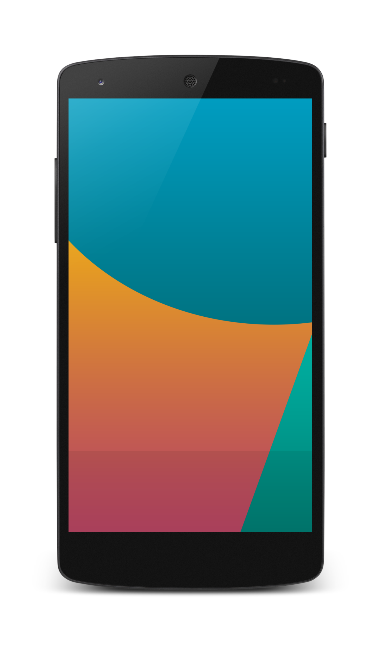

Work Flow Diagram (Scenario 2)
Notifying User
PIR Motion Sensor
Temperature Sensor
DS18b20
1
2
Room is monitored for temperature, till the time it is occupied.
PIR Motion Sensor , detects movement in room and interrupts Rpi.
Rpi checks current room temperature via Temp Sensor (DS18b20 – 1W Interface)
Temperature data is posted and processed at cloud (PHP / NodeJS)
Mobile Devices are updated via “RSS Feed” , “GCM (Google Cloud Messaging)”
Laptop & Desktops are updated via “RSS Feed”
Cloud Services
(Web+ DB Server)
3
5
4
RSS Feed
RSS Feed
GCM

Slide 9
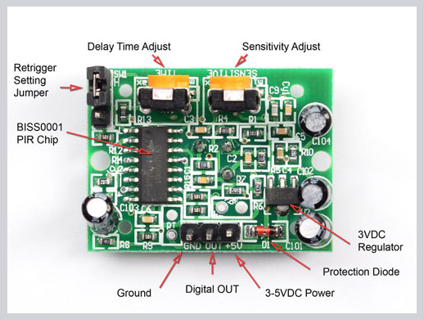
PIR Motion Sensor Explained

Slide 10
Cloud / Backend

Slide 11
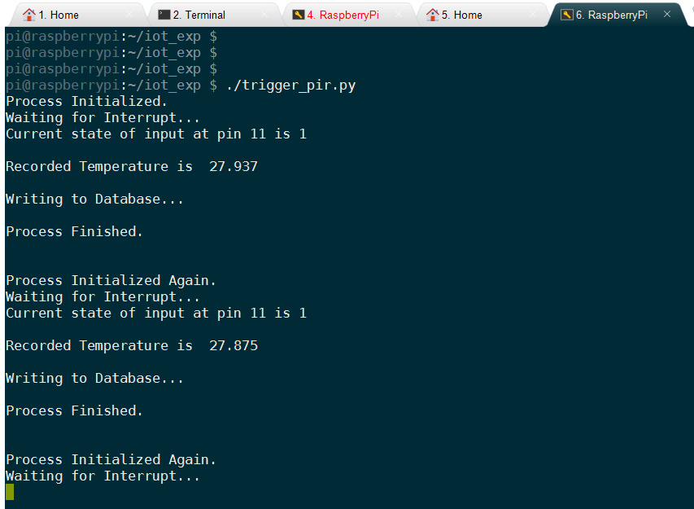
Console Output

Slide 12
Code - Python

Slide 13
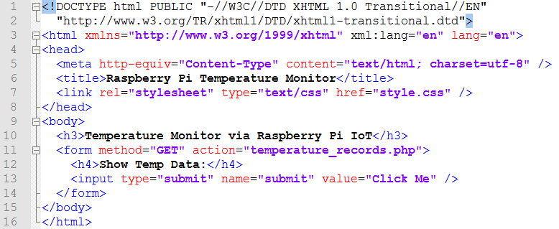
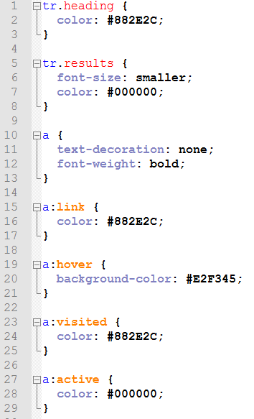
index.html
HTML / CSS
Welcome Page
style.css

Slide 14
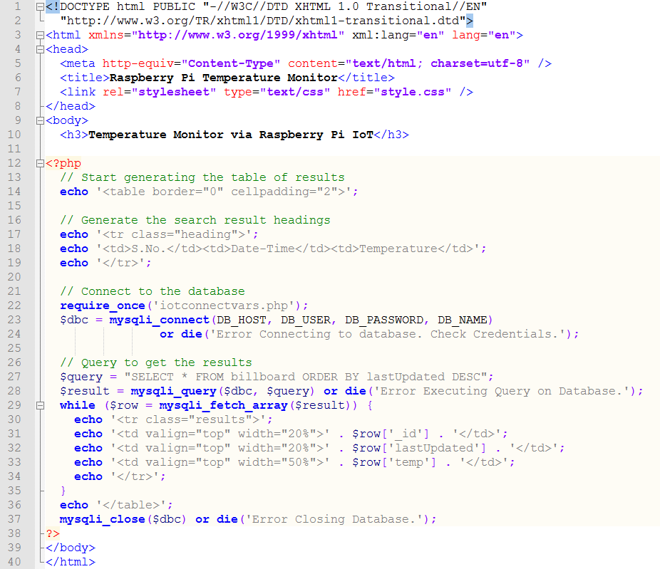
temperature_records.php
Push Temperature Data
To Cloud Server

Slide 15
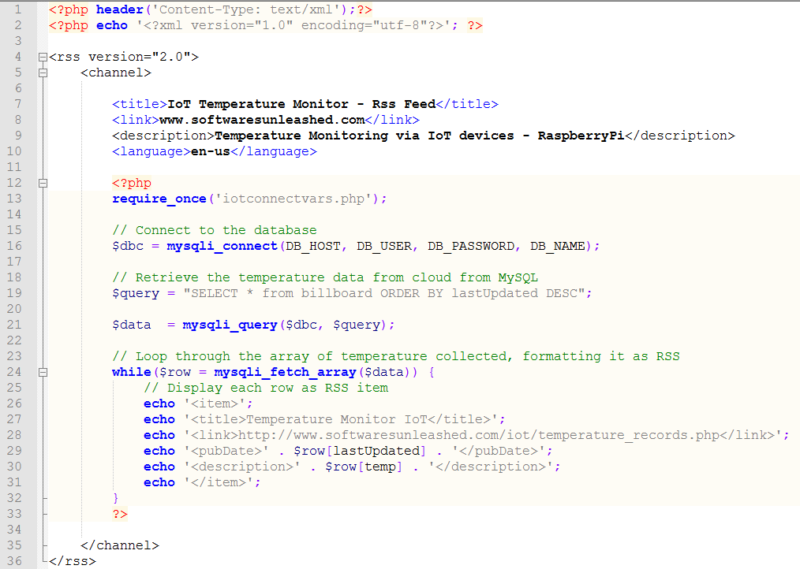
temperature_monitor_rssfeed.php
RSS Feed

Slide 16
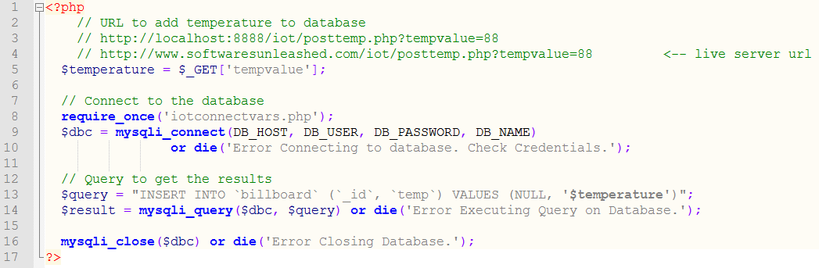
Temperature Posting Script To The Cloud
iotconnectvars.php

Slide 17
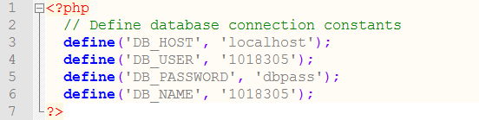
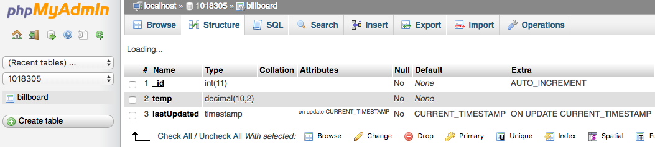
DB Connection Helper
Temp DB Table Structure

Slide 18
Notifying Users / Registered Devices
(Android , iOS, Web Client)
1) RSS
2) Google Cloud Messaging

Slide 19
Notifying Users / Registered Devices
(Android , iOS, Web Client)
1) RSS

Slide 20
Notifying Users / Registered Devices
(Android , iOS, Web Client)
2) Google Cloud Messaging
Creating the Android Application and Connecting it to the Server
Objectives: 1. Receive the temperature readings on your Android device. 2. Display the database of the temperature readings sent by the Pi.
Structural Flow:
To receive the temperature readings on your Android device, we need our Android app to receive data from the cloud server.
For this, we will use Google Cloud Messaging, HTTP Protocol (Downstream messaging).

Slide 21
Notifying Users / Registered Devices
(Android , iOS, Web Client)
2) Google Cloud Messaging
Directional flow of data in GCM Downstream messaging:
Web Server–>Google Cloud Messaging
(The web application will connect to the Google cloud messaging API URL and send a notification message to GCM server to push it to the registered Android device).

Slide 22
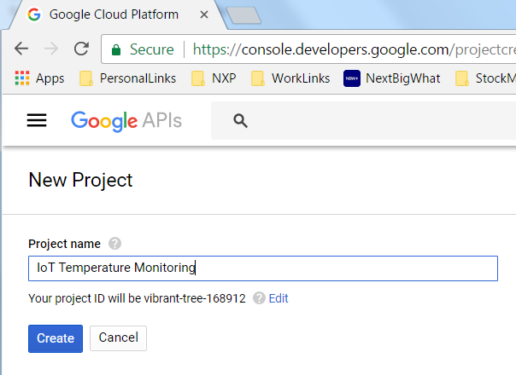
Notifying Users / Registered Devices
(Android , iOS, Web Client)
2) Google Cloud Messaging
First of all, you’ll have to create a Google API key for your application.
Go to Google’s Developer Console (https://console.developers.google.com) and create a “New Project”.

Slide 23
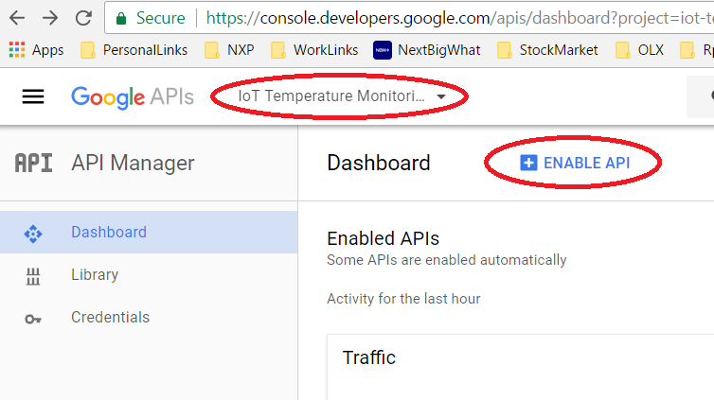
Notifying Users / Registered Devices
(Android , iOS, Web Client)
2) Google Cloud Messaging
Save the project number created with the project. You’ll have to use it when configuring the Android application.
From the API Manager, select Project for which you want to enable GCM and then click on “Enable API” to enable GCM.

Slide 24
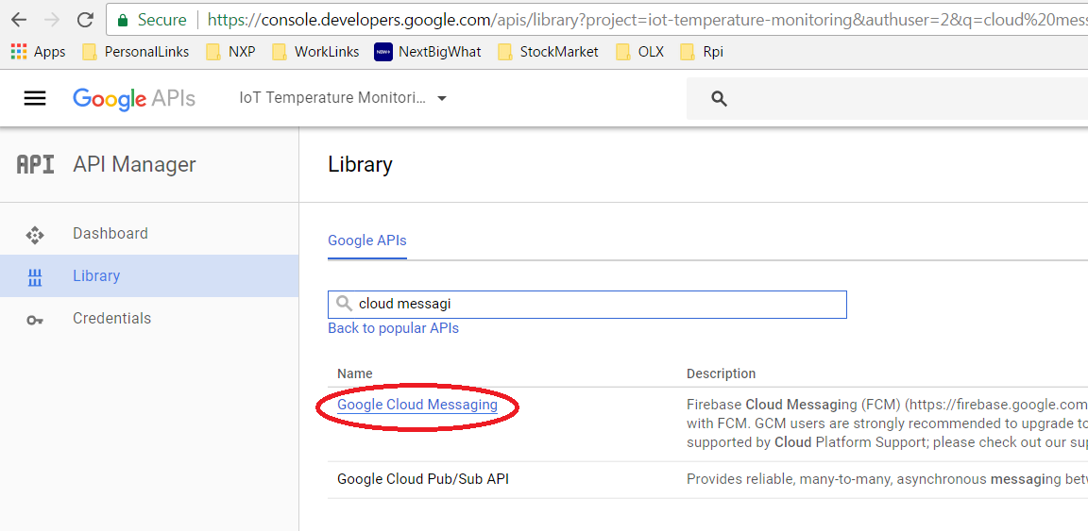
Notifying Users / Registered Devices
(Android , iOS, Web Client)
2) Google Cloud Messaging
In the Search bar, search for “cloud messag”, and then click on “Google Cloud Messaging”

Slide 25
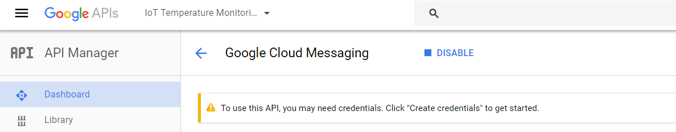

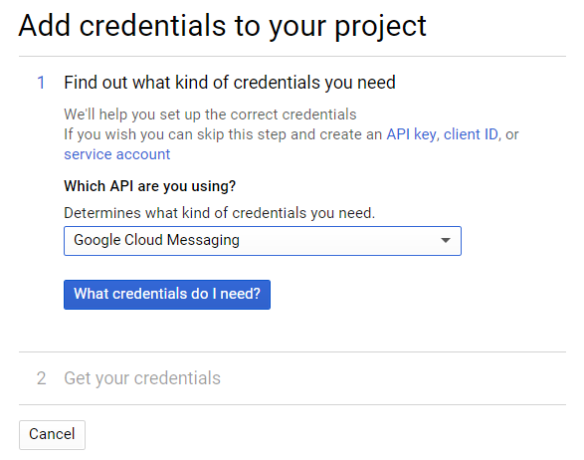
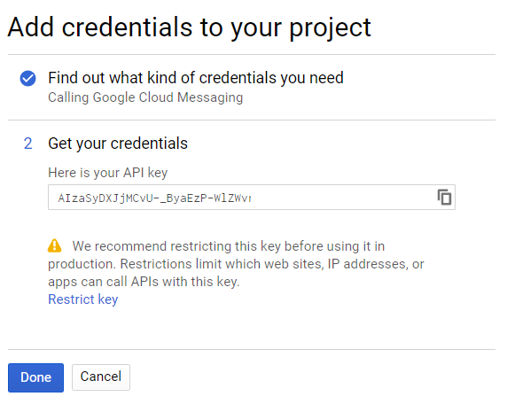
Notifying Users / Registered Devices
(Android , iOS, Web Client)
2) Google Cloud Messaging
Click on Create Credentials, and then click on subsequent buttons.and make a new server key (do this from the same device that hosts your web server). Save the API key generated, it will be used when the server communicates with Google service.

Slide 26
Notifying Users / Registered Devices
(Android , iOS, Web Client)
2) Google Cloud Messaging
Create a new file ‘sending-push-notifications.php’, with the following code.

Slide 27
Notifying Users / Registered Devices
(Android , iOS, Web Client)
2) Google Cloud Messaging

Slide 28
Notifying Users / Registered Devices
(Android , iOS, Web Client)
2) Google Cloud Messaging

Slide 29
Wrong wiring / connections done between GPIO port & DS1820 temperature sensor
GPIO #4 had to be registered with W1 drivers via /boot/config.txt file.
(Name of the GPIO pin had to be used, and not the physical GPIO pin number.)
The timing / sensitivity rotatory rheostats had to be configured to generate little time duration interrupts.
Major Hurdles Conquered

Slide 30
Python (GPIO Pin Configuration)
PHP / MySQL (Cloud / Backend)
HTML / CSS (Welcome / Temperature Display Page)
Technologies Exploited

Slide 31
PHP Storm (Backend Code)
Android Studio (Android App)
vi / vim (Python Scripts on RaspberryPi)
Softwares

Slide 32
Internet connection 24x7 is needed for proper functioning of the proposed system.
Accuracy of Temperature sensor to predict temperature can affect working of system. This risk can be mitigated by adding multiple Temperature sensors in series and averaging their value.
Accuracy of PIR Motion Sensor can affect proper working of the system.
Risks

Slide 33
Room is automatically monitored till its occupied using PIR motion sensor.
Algos running on cloud servers , find out the current weather (summers/ winters) , based on the temperature data collected.
These algos, bring temperature to normal room temperature (25 deg C), by switching on / off relevant appliances (Heater / AC / Fan).
Innovation

